Slide 1

Socialisation
Lesson Objectives:
Define Socialisation
Explore the Agencies of Socialisation
Critique these ideas – using Moral Panics

Slide 2
What Is Socialisation?
Think back to last week’s lesson and speak with those on your table to answer the following questions
What is it?
What institutions/agencies socialise us?

Slide 3
Defining Socialisation
Process by which we learn to become members of society, both of internalising the norms and values of society and also by learning to perform our social roles (as worker, friend, citizen and so forth
It continues throughout people’s life course
It happens before we are even born
Distinguished between primary and secondary socialisation
It is NOT a one-way process
Whilst people are shaped by it, people can redefine their social roles and obligations
What worked for your parents and grandparents may not always work for you or your children’s generation
(Scott 2014: 710)

Slide 4
Homework
Work with the person next to you and review which sources you used for the homework task to compare.
Did you use similar sources or different?
Did you come to similar conclusions about Good/poor/ancedotal in terms of style, language etc?

Slide 5
Agencies of Socialisation

Slide 6
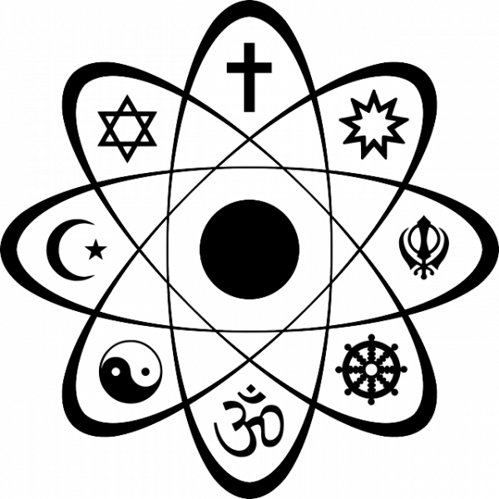




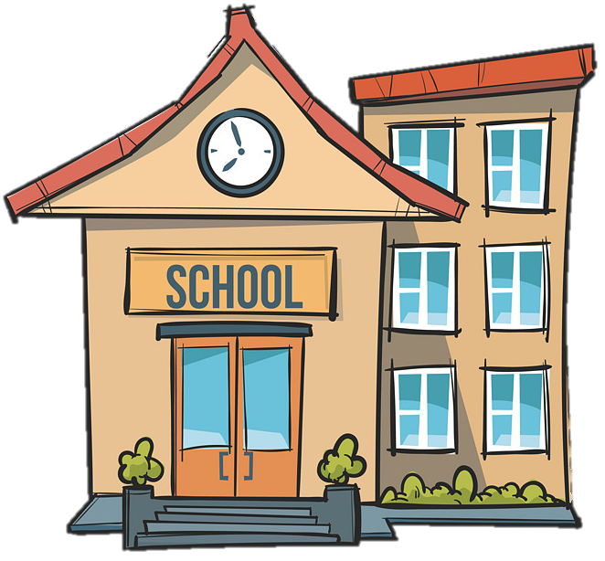
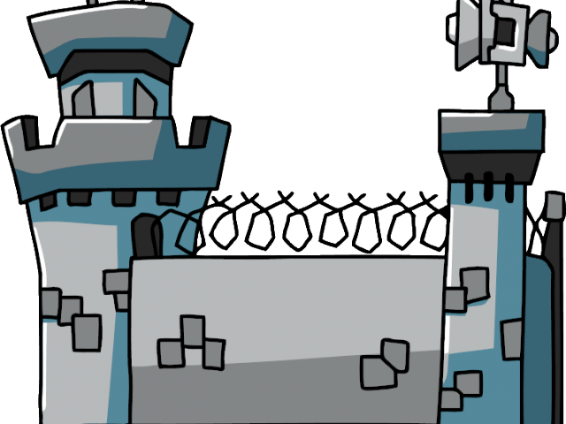
Who/What Are The Agencies of Socialisation?

Slide 7

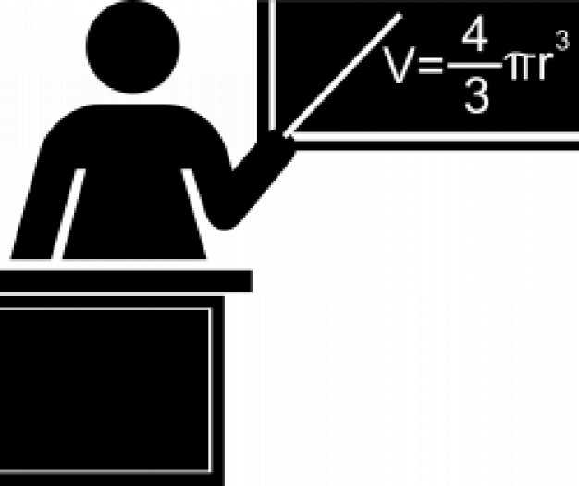


Agencies of Socialisation
Who are the key people and groups involved in the socialisation of children and young adults at the following ages?
0 - 4 years
5 - 10 years
11 - 15 years
16 - 21 years
22 - 65 years
66 years - death

Slide 8
The Family
Argued to be the most important agency
We interact with them from birth to death
They provide primary socialisation
The definition of family is ever-changing
This helps overcome the normative values of the Nuclear Family
We learn from them through Role Modelling
‘When an individual observes another person’s behaviour & modifies their own behaviour to replicate theirs’
Our understanding of gender &, to an extent, sexuality is primarily shaped by the family
The way the gender roles are played in the family impacts the family whole structure
Direct or external family

Slide 9
What Do You Think About The Family Teaching You?
What general rules do you think the family teach us?
Do you think the family have a major role in teaching us about gender?
Do you think the family have a major role in teaching us about sexuality?

Slide 10
Education
Split into Formal and Hidden Curriculum
Formal:
Subject knowledge, employment skills, life skills, etc…
Hidden:
Everything learnt outside of the formal lesson plans
Such as: timekeeping, etiquette, knowing how to be on the good side of your Sociology Lecturer, etc…
Argued to be the most important and powerful curriculum
Question
Can you think of anything in your current or previous experience in education where the Hidden Curriculum has been pivotal?
Notes:
Make sure the examples provided for the question are suitable and something you are comfortable sharing with everyone.

Slide 11
Positive View of Secondary Socialisation At School: Parsons
Families are taught certain values
These will differ and could result in societal divisions continuing through new generations
Schools teach people universal norms & values which children must stick to
Children learn success is based on ability
Work hard & you will be successful
Hidden curriculum teaches children what they need to do to be successful in society
Notes:
Parsons is a Functionalist

Slide 12
Negative View of Secondary Socialisation at School: Bowles & Gintis
Whilst schools teach us the most intelligent people get the best results, this is NOT true
Children are taught to respect authority and ‘accept boredom’
Middle-Class values
Those who perform better are not always the smartest
They adhere to Middle-Class norms & values & are rewarded for doing so
Many Marxists such as B&G argue schools socialise children to accept society’s structure as being fair
Keeps ruling class in power & Working-Class subordinate
In short, schools make Working-Class people accept the unfair societal structure & subordination of certain people
Notes:
Bowles & Gintis are Marxists

Slide 13
Religion/Belief Systems
People’s norms and values have been heavily influenced by Religion/Belief Systems
Secularisation is a term used to argue Religion has less, sometimes no, importance in society & its norms and values
However, Christianity still plays a major role in the UK’s curriculum
Physical attendance to Churches & other places of worship may not be as high as previous generations, but the faith or belief’s influence is still high

Slide 14
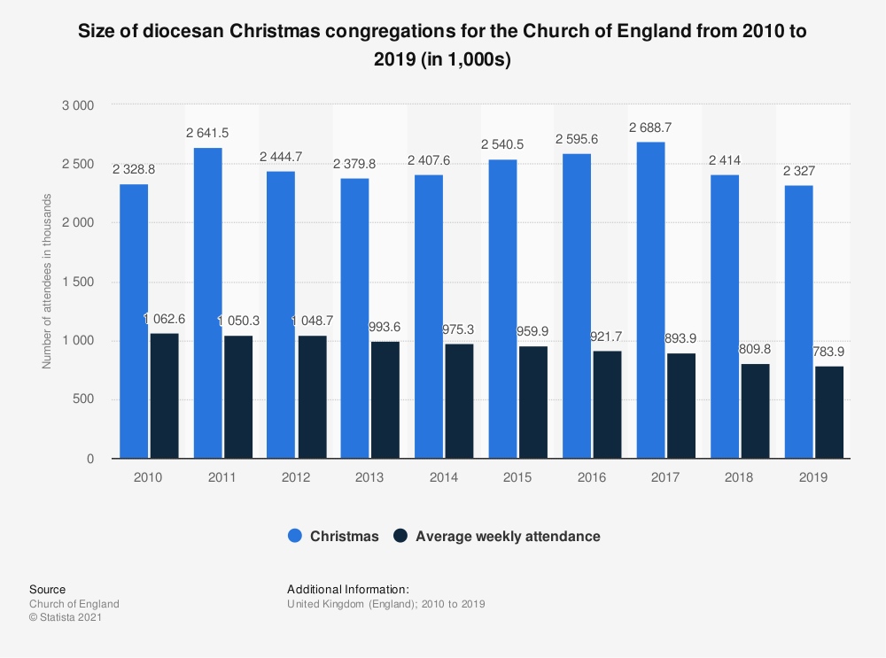
Over 2.3 million people in England attended a Christmas church service in 2019, compared with the average weekly attendance of 783 thousand people. Between 2010 and 2019, the average number of regular worshippers in the UK fell by around 191.7 thousand, while the attendance at Christmas has fluctuated between 2.32 and 2.69 million people in the same time period
Notes:
As you can see here, there is a case for the importance of religion, in this case Christianity, even with secularisation. The idea of Christmas for Christians still has a focus on the stories of the birth of Jesus and the idea of him dying for our sins. The idea of loving each other during this period and bringing cheer and happiness to people are universal values which Religion heavily emphasises as being important to ‘civilised’ (in the normative sense) societies. Therefore, the argument that Religion has lost its importance in society does not mean it is entirely irrelevant, look at other Religions such as Islam, but its impact on how people should behave is still powerful and a major crux which underpins contemporary societies.
Source: https://www.statista.com/statistics/947972/christmas-church-attendance-in-england/#statisticContainer

Slide 15
The Mass Media
Mass Media includes:
Printed Media/News, TV, Internet, Social Media, Video on Demand, Books, Magazines, Billboards, Street Art/Graffiti
Many debates on how powerful the Media is at influencing
Been blamed for many Mass Shootings:
E.G. Columbine
Been praised for providing role models to emerge:
E.G. Marcus Rashford
Representations of people have been questioned
Feminists argue women are under and misrepresented more than men as well as learning their roles in society are not as important
Known as: SYMBOLIC ANNIHILATION
Representation and portrayals of different ethnicities have also been questioned
Victims of MORAL PANICS

Slide 16
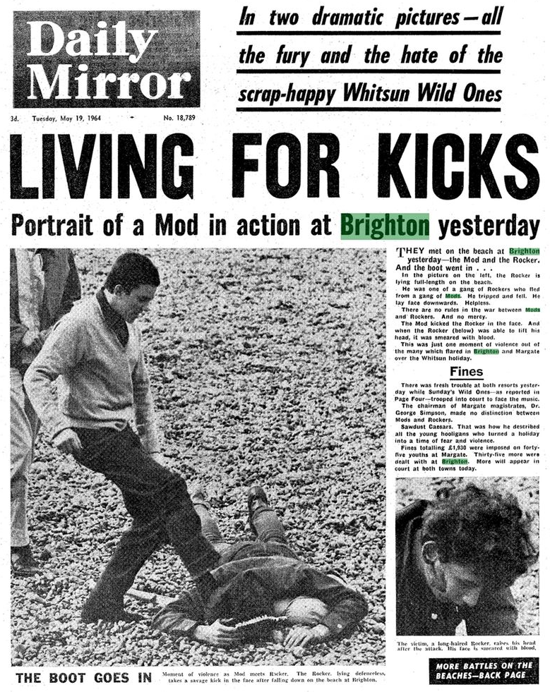
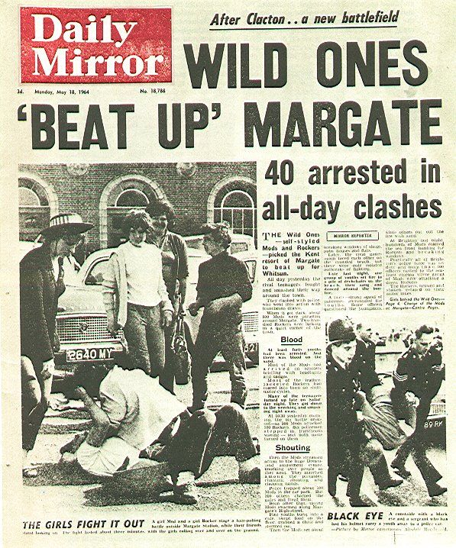
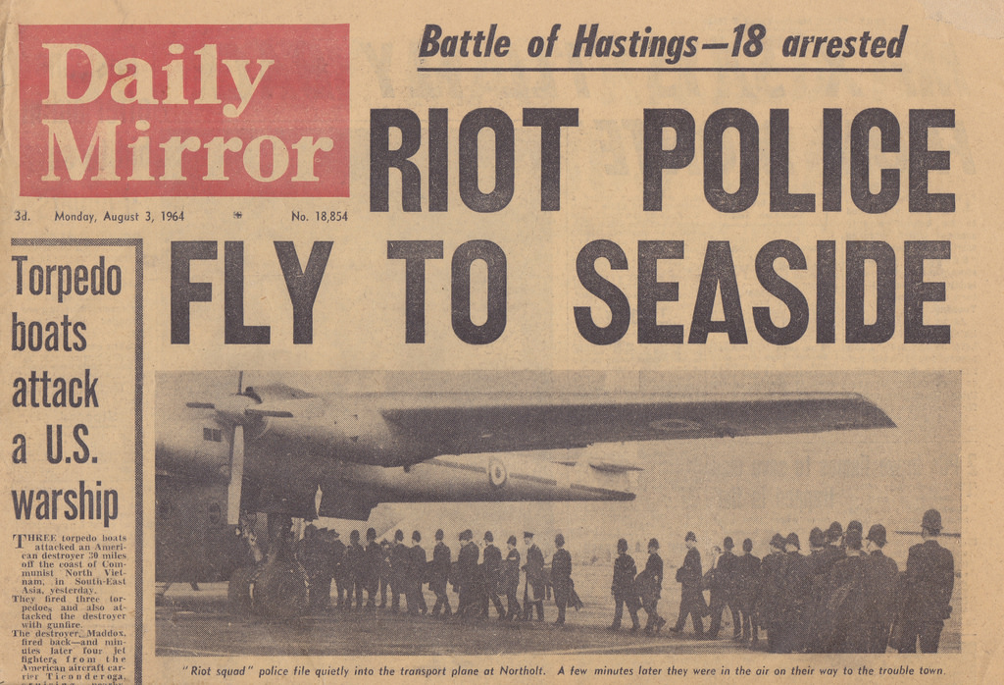
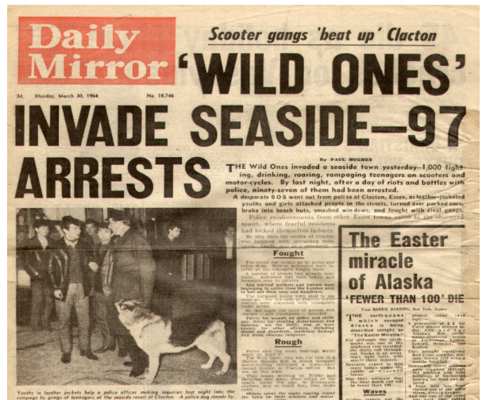
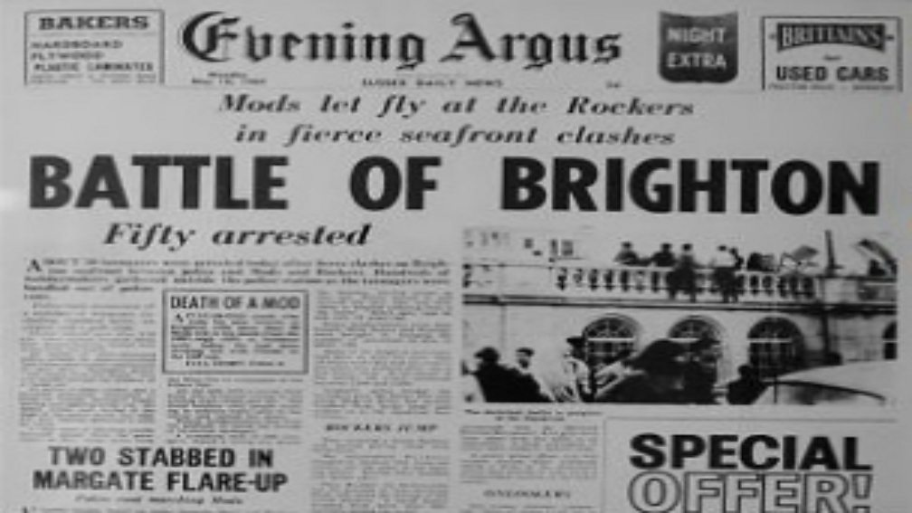
Look at these newspaper articles.
What do you think might have
happened? Why?

Slide 17
What is a Moral Panic?
Cohen defined it as:
Societal overreaction to a certain group or type of behaviour that is taken as symptomatic of general social disorder
Usually driven or inspired by the media
In a Moral Panic:
Media identify a group as a Folk Devil or Threat to Societal Values
Media present the group in a negative, stereotypical way and EXAGGERATE the scale of the problem
Moral entrepreneurs, editors, Politicians, Police Chiefs, Bishops and other ‘RESPECTABLE’ people condemn the group and its behaviour
Notes:
Mods, Rockers and Moral Panics – YouTube
Also -
https://www.youtube.com/watch?v=cgku2eurXac&pp=ygUMbW9yYWwgcGFuaWNz
https://www.youtube.com/watch?v=XXcIcrWueBI&pp=ygUMbW9yYWwgcGFuaWNz

Slide 18
Related pieces of crime and
deviance are over reported &
given more prominence than
otherwise would have
Media presents a distorted
view of the level of crime
Distorted view creates
public concern
This keeps
the issue
high on the
public
agenda
MORAL PANIC
Police records reinforce
the idea there’s more
crime & deviance
The police are more aware
or sensitive to the problem so
they discover more crime
The police want something
done about the problem

Slide 19
Few groups of bored young
people started throwing
stones at each other
Mods & rockers started
separating out
Clacton – small holiday resort
On East coast of England.
Easter Sunday 1964
Windows
broken, some
beach huts
wrecked – 2
unpleasant
days
MORAL PANIC/
DEVIANCY AMPLIFICATION
Further disturbances –
Public outcry – Further
arrests
Media distorted what was
going on – encouraged other
young people to behave in
the same way.
Next day – sensationalist
headlines in newspapers

Slide 20
In Conclusion
Socialisation is a process which Sociologists argue from before birth through to death
There are many agencies which socialise us
Family is argued to be the most important
Whilst Secularisation has occurred, the importance of Religion and Belief Systems are still strong
The Mass Media have the most outreach for spreading ideology
It appears they are not as important as the family as there are many outlets with different views
They are also not as ever-present like a family member
Moral Panics continue to be used and shape our perception of the world and other groups of people

